Slide 1

Hot & Fast
Implementing GraphQL backend & Blazor Frontend with Hot Chocolate!
Michael Staib
Microsoft MVP & Author of Hot Chocolate
José Luis Latorre
SW Lead architect at Zühlke
Founder .NET UG Zürich

Slide 2


Slide 3
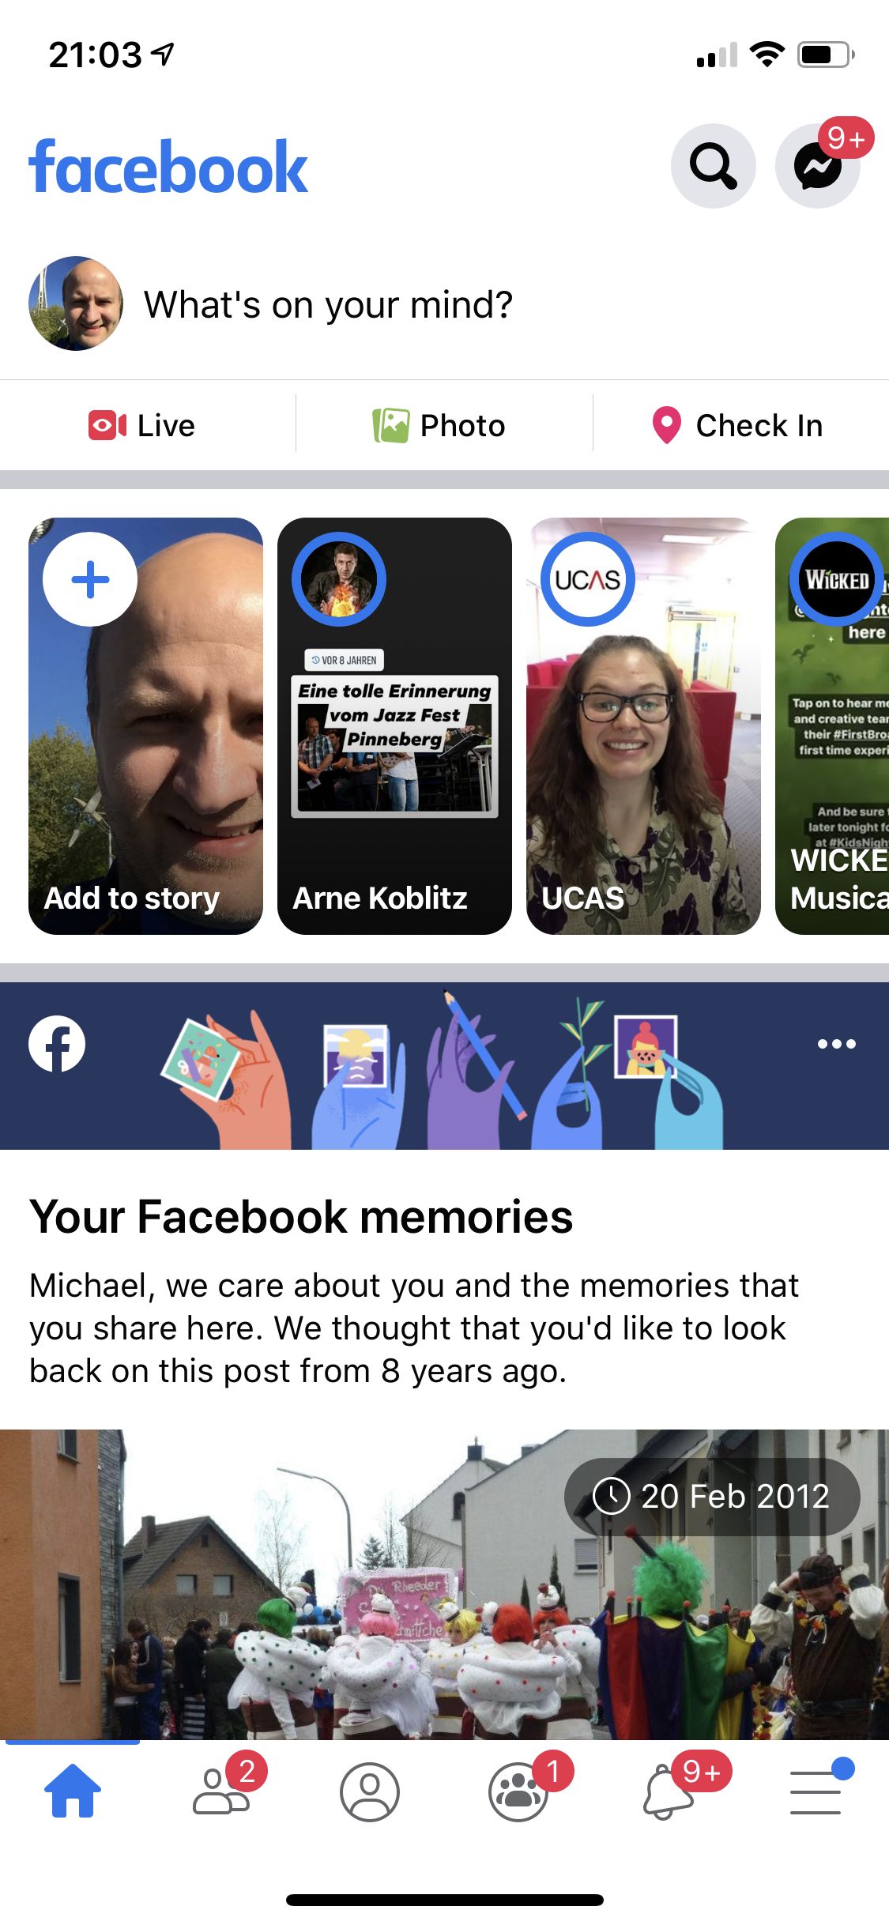


Slide 4
Rest API Requests
https://graph.facebook.com/{your-user-id}
https://graph.facebook.com/{your-user-id}/feed
https://graph.facebook.com/{your-user-id}/photos
https://graph.facebook.com/{your-user-id}/friends
…

Slide 5
GraphQL API Requests
https://facebook.com/graphql

Slide 6
GraphQL
One Endpoint
No over- or under-fetching
Simplicity
Real-time
Predictability
No versioning
One Request
Type System
Documentation

Slide 8


.NET

Slide 9

SPA framework.
.NET Core 3.0 in the browser.
Yes, this means No JavaScript.
Base technology is WebAssembly.
Near native speeds.
Open Source.
Looks like Microsoft has learned from previous experiences..

Slide 10
Why .NET for browser apps?
Modern languages (C#)
.NET ecosystem
Performance
Full-stack
Tools
Stable & mature

Slide 11
DEPENDENCY INJECTION
SERVER-SIDE RENDERING
COMPONENT MODEL
FORMS & VALIDATION
DEBUGGING
PUBLISHING
Blazor
ROUTING
LAYOUTS
UNIT TESTING
AUTO REBUILD
ASSEMBLY TRIMMING
JAVASCRIPT INTEROP
INTELLISENSE & TOOLING
COMPONENT PACKAGES

Slide 12
Server-side
(Blazor Server)
Client-side
(Blazor WebAssembly)
Shipped
Part of .NET Core 3.0
Preview now
Release target: May 2020
Blazor + Electron
(Desktop app with web rendering)
Blazor + Native UI
(Mobile/desktop with native OS UI)
Uncommitted
Sample available now
Very experimental!
Super-early, no sample yet

Slide 13


Slide 14
Let’s build something

Slide 15
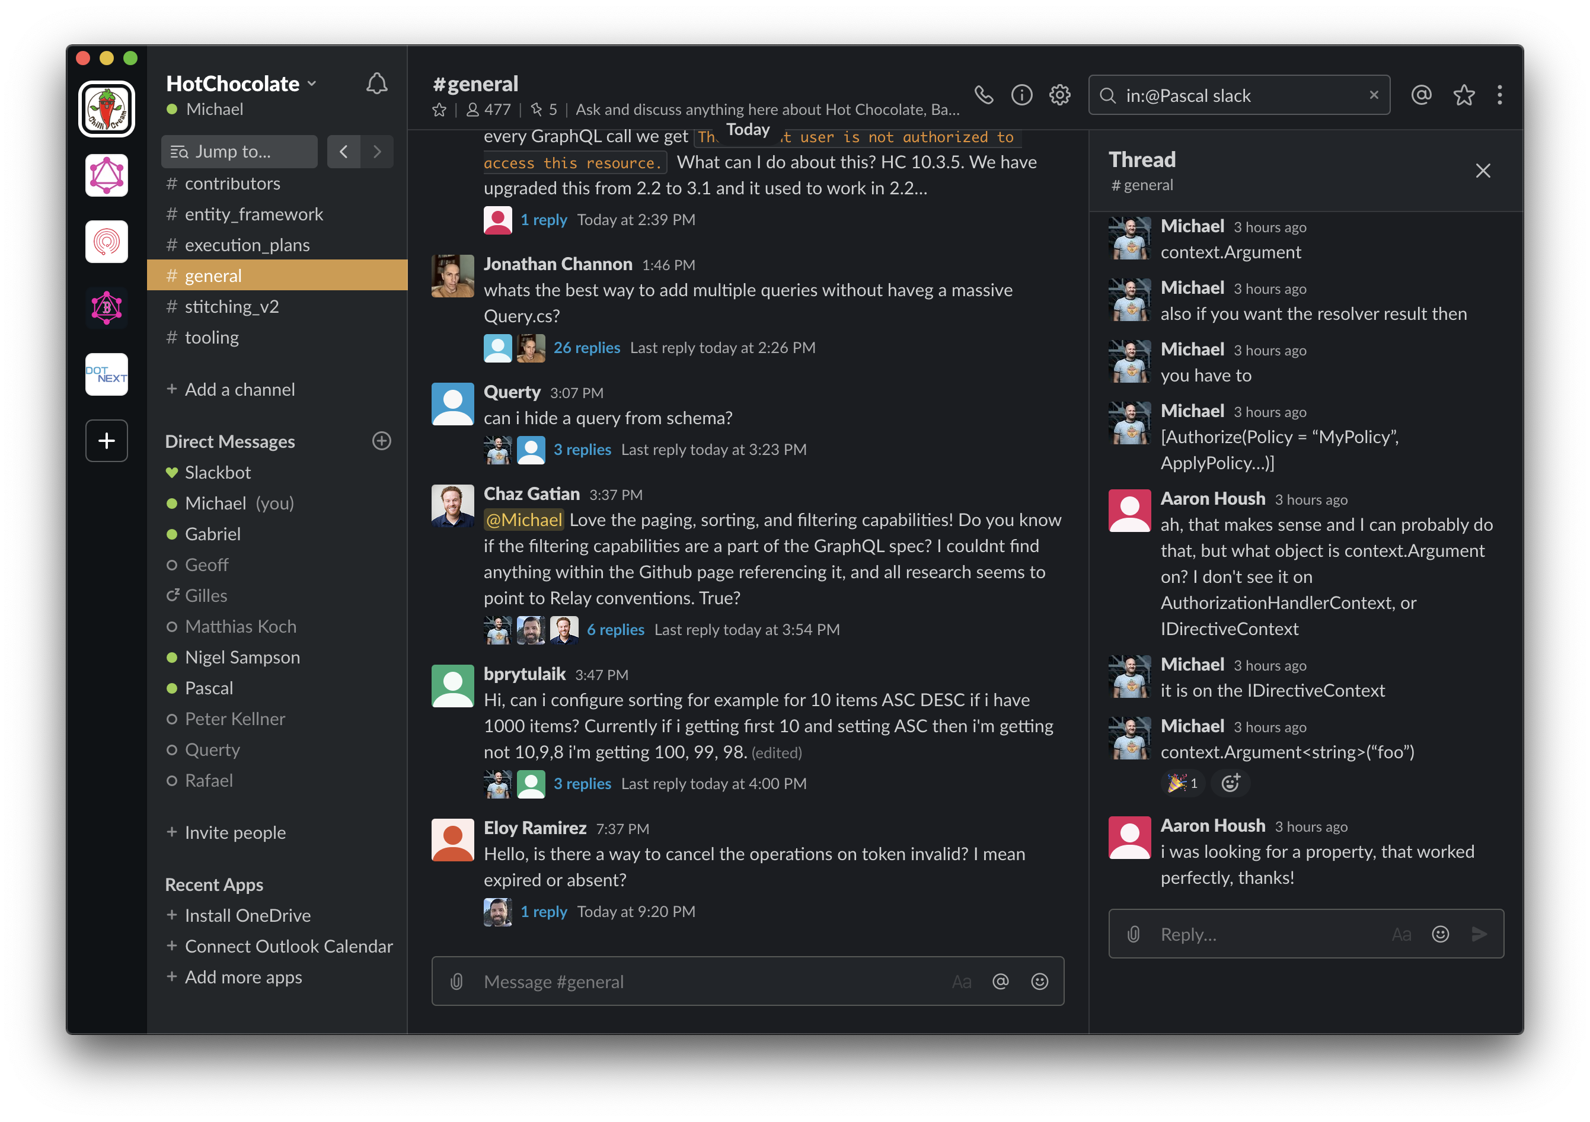

Slide 16


Slide 17
So, all Good things reach an end..
We showed you..
How Blazor and GraphQL work together
How Hot & Fast is to build an application with these technologies
The main benefits & synergy

Slide 18
Outlook

Slide 19
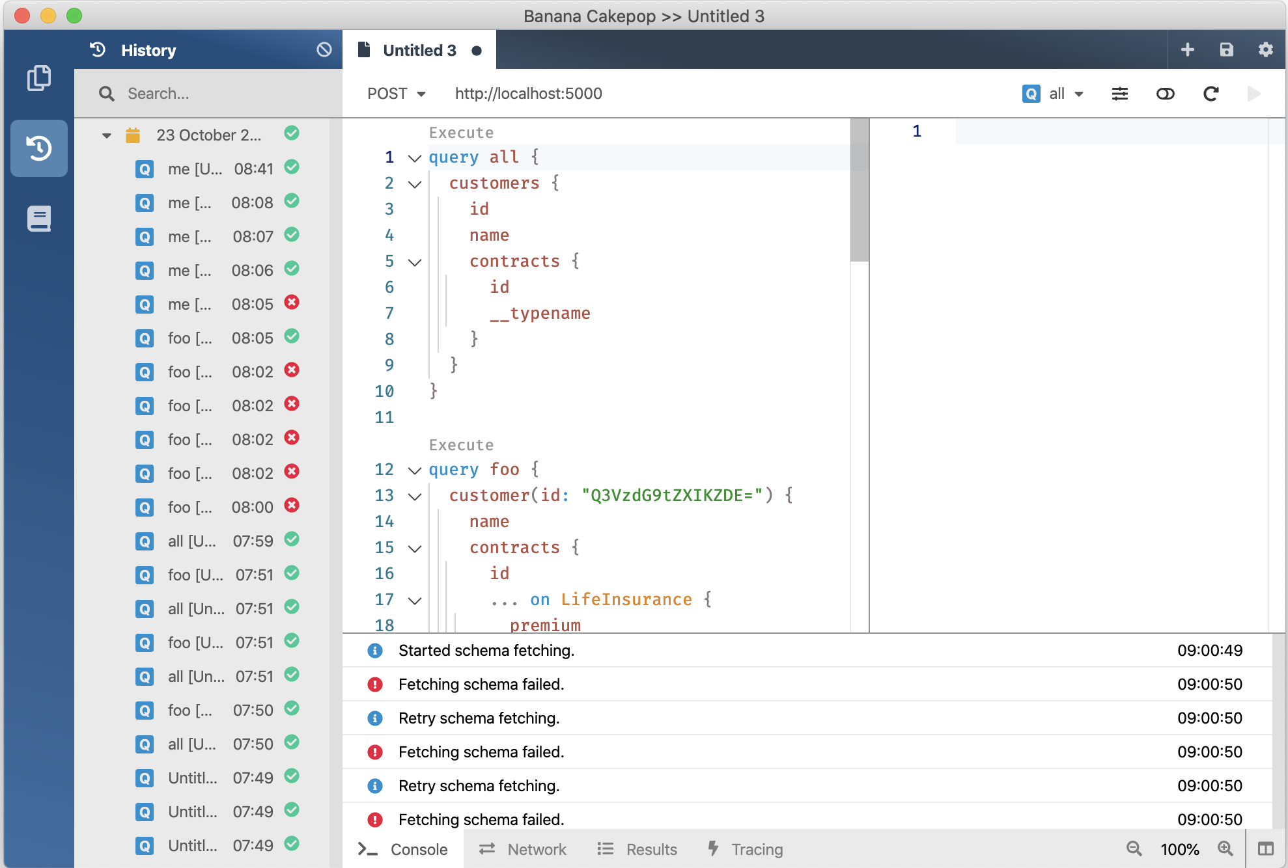
V10
GraphQL Gateway
V11 January 2020
V12 August 2020
GraphQL Client
GraphQL Server
Developer Tooling
Supports Blazor and Xamarin
Execution Plans @defer @stream
Schema Registry (Schema Change Tracking, CI Tools)
Automatic Database Mapping
GraphQL Analytics
Operations Manager (Execution Plan Store, Whitelisting, Client Registry)

Slide 20
Where do you find us?
https://hotchocolate.io
https://chillicream.com
https://github.com/ChilliCream/OxfordDotNetMeetup2019
https://twitter.com/Chilli_Cream
https://github.com/ChilliCream

